Slide 1
TRAINING WORKSHOP
TEACHING SPEAKING COMMUNICATIVELY

Slide 2
Learning OUTCOMES
Identify students’ concerns about speaking in class
Identify teachers’ concerns about teaching speaking
Find solutions to students’ and teachers’ concerns related to speaking
Notes:
Definition of Speaking: It is one of the four macro skills. It is a productive skills to the same extent as Writing.

Slide 3
1. Why are students reluctant to Speak in class?
2. What concerns do some teachers have when teaching speaking in class?
3. Identify and discuss solutions for each concern
Notes:
Work in groups of four to answer the following questions
Draw two columns; write students’ concerns in one and teachers’ concerns in the other

Slide 4
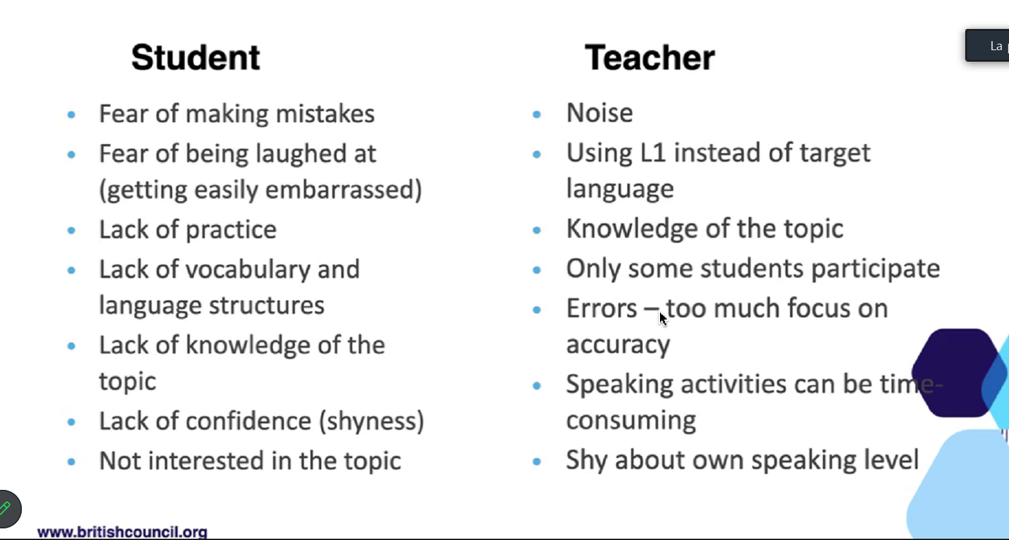
SOME CONCERNS IDENTIFIED

Slide 5
SOLUTIONS
STUDENTS TEACHERS
Scaffolding
Personalisation
Motivation
Feedback
Notes:
1- create context, provide vocabulary, show how to use it,
2- making it communicative (putting the student at center of his/her own learning, choosing a topic that is relevant to their lives (ex: your dream job)
3- There has to be a reason them to speak. A need to know something. There should be an information gap
4- Provide feedback on the langage used and on the content (the unfolding task itself)

Slide 6
In two minutes write down as many jobs as you can
What job do you want to do in the future?
Describe your favorite job. (clothes: wear – place: work in/at …– Time: night, day etc Action: repair, cooks, grow, teach,…

Slide 7
DEMONSTRATION

Slide 8
Prerequisites
-List of jobs and their description
-Asking questions. YES/NO questions
Notes:
Example: The Job in my mind: Carpenter
I am going to choose a job in my mind. You are going to ask me 10 yes/no questions to find what job it is.
-Do you wear a uniform for your work? -Do you need a car for your work? -Do you repair cars ? -Do you prescribe medicines to people?
-Do you assure people’s security? -Do you use weapons in your work? -Do you use money in your work? - Are you a teacher? Are you….? Is there …..at your workplace? …..

Slide 9
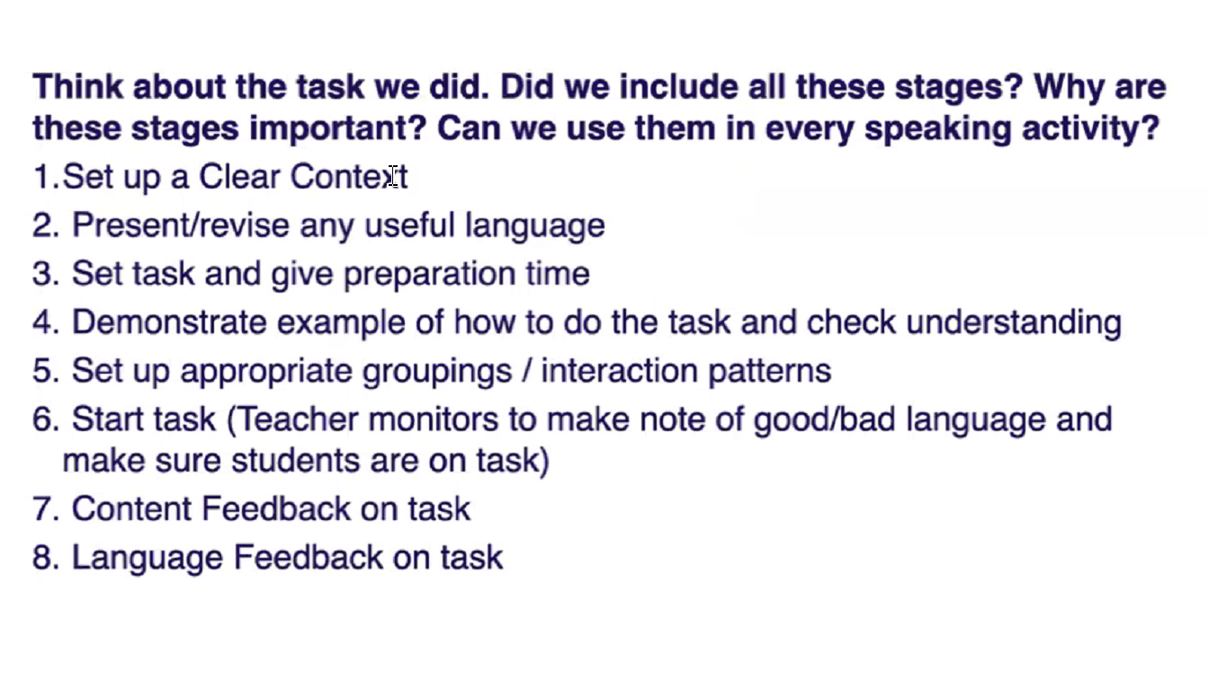
Stages in a Speaking Activity

Slide 10
Teacher Practice: Group Work
Game time!!!
Notes:
Get in groups of five. Each group presents individually.
One teacher chooses a job; others ask yes/no questions to find out what job it is. Take turn in the group.

Slide 11
FEEDBACK
-What did you like or dislike about the task ?
-How will you implement the lesson to your own class?
-What are some possible challenges that you could face?
-How could you apply the staging to different speaking activities?
Notes:
Some themes that are dealt with in our textbooks are: means of transportation - home furniture- foods and drinks - Colours - etc

Slide 12
ONLINE RESOURCES
Suggested activities
Disappearing dialogue: https://www.teachingenglish.org.uk/teaching-resources/ teaching-primary/activities/level-1/vanishing-dialogue
Picture dictation: https://www.teachingenglish.org.uk/teaching-resources/ teaching-primary/activities/level-2/picture-dictation Scaffolding: https://www.teachingenglish.org.uk/publications/case-studies-insightsand-research/why-wont-they-speak-english
Courses: How to Teach Pronunciation: https://www.teachingenglish.org.uk/training/ teachingenglish-how-teach-pronunciation
Teaching Speaking: https://www.teachingenglish.org.uk/training/ teachingenglish-how-teach-speaking

Slide 13


