Slide 1
THE IMPORTANCE OF TEACHING READING COMPREHENSION
Reading comprehension is one of the most important skills a person can have. It is essential for success in school and in the workplace.
Some reasons why reading comprehension is so important include:
The ability to read and understand texts is essential for success in school. Good reading comprehension skills are necessary for understanding textbooks, lectures, and other class materials.
The ability to read and understand texts is also important for success in the workplace. Employees who can read and comprehend instructions, memos, and other work-related documents will be more successful than those who cannot.
Good reading comprehension skills also allow people to better understand the world around them. They can better follow the news, understand complex concepts, and make informed decisions.

Slide 2
READING AND CLT : GENERALITIES
Reading , mostly in a foreign language situation involves complex psycholinguistic and mental processes whereby readers decode linguistic forms or use their knowledge of the world , separately or interactively to make sense of written discourse. And, CLT fundamentally rests on three principles which Reading should cater for to produce competent Learners:
Integration: According to the principles of task dependency, (Nunan 2007),tasks are in combination with each other ; each task is explicitly related to another in a continuum (Tardif, 2018).

Slide 3
Contextualization: Each task relates to an authentic problematic situation to be solved by students with the resources that are available.
Learner-centeredness and autonomy: Learners are , through discovery procedures, responsible for their learning with the teacher’s facilitation.
Different scholars have looked at the same entity from different angles and have reached somewhat different conclusions about the nature of reading . While some have studied reading to uncover the underlying processes , others have tried to identify its sub-skills for teaching and testing purposes.

Slide 4
PRE -READING
Use pre reading activities:
To assess students’ background knowledge of the topic
To give students the background knowledge necessary for comprehension
To Clarify cultural information that can hinder comprehension.
Here the process is called INSTIGATION.

Slide 5
WHILE-READING ACTIVITIES
While-reading activities focus on the process of understanding rather than the result of reading.
a) Skimming for the main idea
Many strategies can be used. You might read:
the title,
subtitles,
subheading,
Illustrations,
the first sentence of each paragraph,
Patterns (Comparison/contrast, Cause/effect, Listing/enumeration, process, etc.)
NB: encourage students to read the text quickly without stopping to look up unfamiliar words for understanding of the general/main idea/s (either whole text or subparts if text is relatively long)

Slide 6
b) Checking for Comprehension
1- Information transfer activities using Transition Devices such as:
Tables,
Cyclic diagrams, tree diagrams,
Flow-charts, pie chart, bar chart
Maps
Pictures, drawings
Chronological sequencing
Etc.

Slide 7
Example:
Task: Read the text and complete the table below .
DEFORESTATION
CAUSES (P. 2) | CONSEQUENCES (P.3) | SOLUTIONS (P.4)

Slide 8
3- Inference questions
Example:
Task: What can you infer from the following?
4-true/false
5-multiple choice
Etc.
NB: The processes involved in While reading are called IDENTIFICATION, INVESTIGATION and INTERPRETATION.
Ex 1: Forests are also cut as a result of growing urban sprawl (P. 2) Ex 1: Trees also play a critical role in absorbing the greenhouse gases that fuel global warming (P.3)

Slide 9
POST-READING ACTIVITIES
Should provide the students with opportunities to relate what they have read to what they already know or what they feel and enable them to produce language based on what they have learned through: The process is INTEGRATION.
Review of the content
Work on grammar
Vocabulary in context/word roots
Writing assignment
Discussions
Debates
Role-plays
Project work

Slide 10
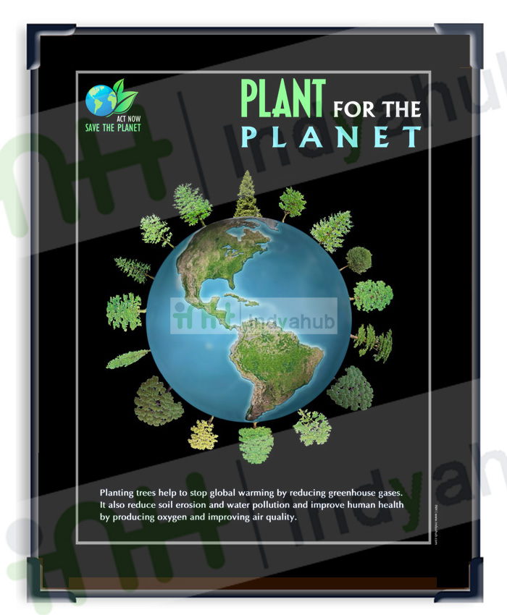
Example: Project Work:
Task: Design a poster to
sensitize against deforestation.
Source: - http://www.indyahub.com/newsletter/gw-sep/images/preview/tree.jpg [consulted on january 13, 2013]

Slide 11
CONCLUSION
The teaching of reading should focus on developing students’ reading skills and strategies rather than testing students’ reading comprehension.
We should view reading as an interactive process.
Reading in the classroom can be divided into 3 stages: pre-reading activities, while-reading activities, and post-reading activities.
The classroom reading procedures tackled should prepare the students for reading testing techniques.

