Slide 1

I. Understanding Motivation
Definition of Motivation
Motivation is a condition that activates and sustains behavior toward a goal. (Pintrich, 2003).
Motivation in learning can be influenced by various factors, including:
Intrinsic Motivation
Extrinsic Motivation
Self-Determination
Goal Orientation
Expectancy-Value Theory
Social and Environmental Factors
Interest and Relevance

Slide 2
I. Understanding Motivation
B. Introducing Relevant Motivation Theories
Motivation theories provide valuable insights into understanding why students engage in certain behaviors and how their motivation influences their actions and decisions. Here are some often discussed in the field of education:
Self-Determination Theory: SDT posits that individuals have innate psychological needs for autonomy, competence, and relatedness.
Expectancy-Value Theory: Students are more motivated when they believe they can succeed in a task and see its value.
Goal Setting Theory: This theory suggests that setting specific and challenging goals can enhance motivation and performance.
Social Cognitive Theory: it highlights the role of self-efficacy or an individual's belief in their ability to succeed in specific tasks.
Achievement Goal Theory: This theory emphasizes the different types of goals students adopt in learning, such as mastery goals and performance goals
Cognitive Evaluation Theory: CET focuses on how external factors, such as rewards or feedback, can influence intrinsic motivation.

Slide 3
I. UNDERSTANDING MOTIVATION
C. The Impact of Motivation on Learning Outcomes
Motivation has a profound impact on learning outcomes. Here are keyways in which motivation affects learning outcomes:
Increased Engagement and Participation
Positive Attitude Toward Learning
Increased Depth of Learning
Development of Intrinsic Motivation
Effective Time Management and Study Habits
Motivated learners actively engage in class discussions, and group activities, enhancing their ability to grasp complex concepts.
Motivation encourages students to view challenges as opportunities for growth and improvement, fostering a positive attitude toward learning.
Motivated learners seek deeper connections within a subject, resulting in a more meaningful and profound comprehension of the material.
Intrinsic motivation, fueled by genuine interest in a subject, is linked to sustained learning and mastery, fostering a lifelong love for learning.
Motivated students exhibit time management skills, allocating time for studying resulting in a more organized and efficient learning process.

Slide 4

II. Challenges in Remote and Blended Learning
A. Identifying Common Obstacles Students Face

Slide 5
II. Challenges in Blended Learning
B. The Role of Teacher-Student and Student-Student interactions
Teacher-student and student-student interactions play pivotal roles in the success of blended learning environments. They are fundamental for creating a supportive and engaging learning atmosphere. Here's an exploration of the importance of each:
Teacher-Student Interactions
Student-Student Interactions
- Guidance and Support
- Motivation and Encourage
- Clarity in Communication
- Monitoring and Feedback
- Building Relationships
- Individualized Support for Diverse Learners
- Collaborative Learning
- Social Engagement
- Diversity of Perspectives
- Peer Support Networks
- Development of Communication Skills
- Promotion of Accountability

Slide 6


II. Challenges in Blended Learning
C. Technology-Related Challenges
Technology-related challenges are common in remote and blended learning environments, impacting both educators and learners. Here are some technology-related challenges:
  Access to Technology
  Digital Literacy and Training
  Technical Support
  Adapting Instructional Strategies
  Security and Privacy Concerns
  Integration of Educational Technology
  Access to Devices and Internet
  Digital Literacy Skills
  Home Environment Challenges
  Software Compatibility Issues
  Online Assessment Challenges
  Time Zone Differences
  Digital Fatigue
  Communication Barriers
TEACHERS
STUDENTS

Slide 7
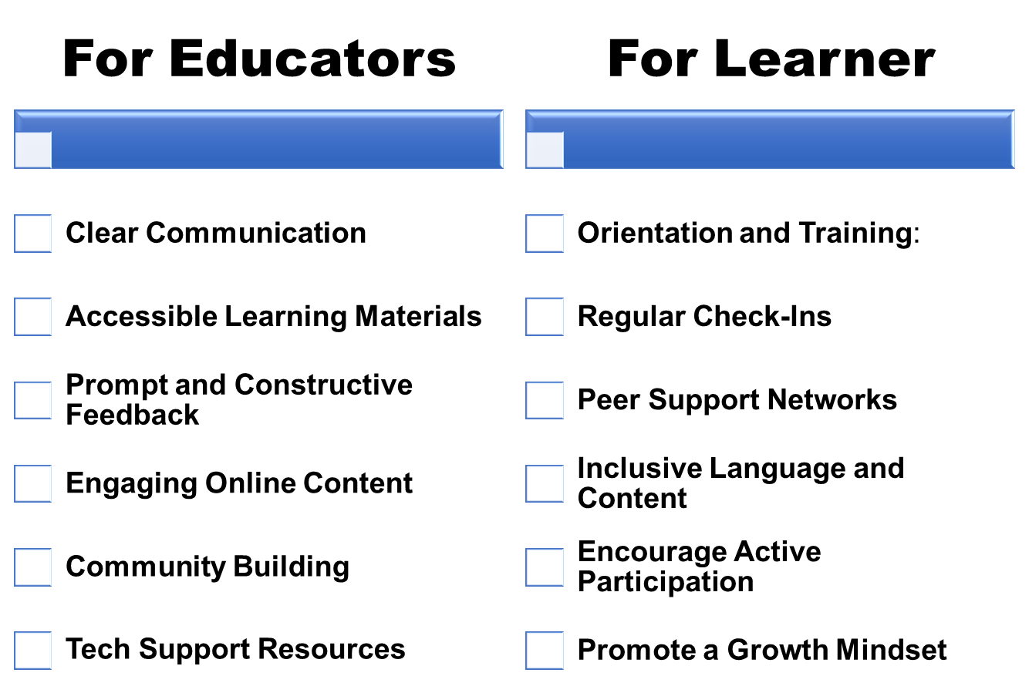

III. Strategies to Motivate Students
A supportive environment contributes to student well-being, engagement, and overall academic success. Here are key strategies for creating a supportive learning environment:
A. Building a supportive learning environment ​

Slide 8
III. Strategies to Motivate Students
Providing opportunities for autonomy and choice not only increases student motivation but also supports the development of critical skills such as decision-making and self-regulation. Here are strategies for fostering autonomy and choice:
B. Fostering Autonomy and Choice​
Goal Setting and Reflection
Flexible Learning Paths
Connect Learning to Real-World
Participation in Decision-Making
Encourage Goal Setting
For Learners
Project-Based Learning
For Educators
Reflect on Learning Styles
Time Management and Planning
Autonomous Research Projects
Students Created Assignments
Initiate Collaborative Projects
Choice in Assessment Formats

Slide 9
III. Strategies to Motivate Students
Active learning involves students actively participating in the learning process rather than passively receiving information. Here are strategies to integrate active learning into your virtual or blended classrooms:
C. Incorporating Active Learning
For Educators
- Facilitate virtual group discussion
- Use online polling tools
- Integrate interactive quizzes or games
- Assign collaborative projects
- Present real-world case studies or scenarios
- Encourage students to prepare and deliver short presentations
For Learner
- Actively participate in virtual talks
- Share findings with the class through presentations
- Work on problem-solving exercises
- Provide constructive feedback to peers
- Create multimedia content
- Discuss reflections with peers

Slide 10
III. Strategies to Motivate Students
D. Encouraging Social Interaction
Promoting social interaction in a remote or blended learning environment contributes to a sense of community and helps students feel connected despite physical distance.
Encouraging both structured and informal interactions creates a well-rounded and supportive virtual learning experience.

Slide 11

IV. Assessing and Adapting
A. Monitoring and Measuring Student Motivation
Monitoring and measuring student motivation in remote or blended learning environments is of paramount importance for educators to understand the effectiveness of their instructional strategies and make informed adjustments..
Monitoring Strategies
Measuring Strategies
  Track virtual class attendance
  Analyze trends in login frequency
  Administer surveys or feedback forms
  Incorporate peer assessments to gauge students' perceptions
  Implement self-reported motivation scales to measure students' intrinsic and extrinsic motivation.
  Collaborate with students to set personalized learning goals.
  Analyze students' performance on assessments and assignments as an indirect measure of motivation.
  Administer pre- and post-surveys to assess changes in motivation levels

Slide 12

IV. Assessing and Adapting
B. Case Study: Example of Successful Motivation Strategies
SenEcole: Technology-Enhanced Learning
Overview: SenEcole is an initiative that aims to improve education in Senegal through technology-enhanced learning.
Motivation Strategy:
Digital Learning Resources: SenEcole provides digital learning resources, including online courses and interactive content. By leveraging technology, the initiative aims to make learning more engaging and accessible.
Impact:
Increased Access: SenEcole contributes to increased access to educational resources, motivating students by providing them with tools for self-directed learning.

Slide 13
V. Teacher's Role in Motivating Students
A. The importance of Teacher Enthusiasm and Support
Here are several reasons highlighting the importance of teacher enthusiasm and support:
Enthusiastic teachers inspire a positive attitude toward learning.
Enthusiastic teachers contribute to a positive and welcoming classroom atmosphere.
Teachers who express enthusiasm and provide support contribute to building students' confidence.
Enthusiastic teachers can ignite a passion for learning within students.
Enthusiastic teachers often build strong connections with students.
Enthusiastic and supportive teachers serve as positive role models for students.
Supportive teachers are attuned to the individual needs of students.
Enthusiastic and supportive teachers often foster a growth mindset.
Enthusiastic teachers can maintain a well-managed classroom through positive reinforcement.
Supportive teachers contribute to the development of student resilience.
Enthusiastic and supportive teachers often foster positive relationships with parents.

Slide 14
V. Teacher's Role in Motivating Students
Here's a comprehensive guide to professional development for online teaching:
1. Foundational Skills
2. Pedagogy for Online Learning
Online Teaching Basics:
Understanding the fundamentals of online teaching
Tech Literacy:
Building proficiency in the use of online learning platforms
Effective Instruction Design:
Learning to design engaging and interactive online courses
Differentiated Instruction:
Adapting teaching methods to accommodate diverse learning styles
B. Professional Development for Online Teaching
3. Assessment and Feedback
4.Technology Integration
Online Assessment Strategies:
Developing effective methods for assessing student learning
Timely and Constructive Feedback:
Providing feedback that is prompt, constructive
Digital Tools for Teaching:
Exploring and integrating educational technology tools
Interactive Content Creation:
Mastering the creation of engaging multimedia content

Slide 15
V. Teacher's Role in Motivating Students
5. Building Community Online
6. Student Engagement
Creating a Positive Classroom Culture:
Strategies for fostering a sense of community and connection
Effective Online Communication:
Developing communication skills tailored to the online environment
Active Learning Online:
Implementing techniques to keep students actively engaged
Discussion Facilitation:
Encouraging meaningful online discussions and collaborative activities.
B. Professional Development for Online Teaching
7. Time Management for Online Educators
8. Assessment of Online Teaching
Effective Time Management:
Strategies for organizing and managing time efficiently in an online teaching environment.
Balancing Workload:
Finding a balance between teaching responsibilities.
Self-Assessment:
Reflecting on teaching practices and identifying areas for improvement.
Peer Evaluation:
Engaging in peer evaluations and feedback to enhance teaching effectiveness.

Slide 16
V. Teacher's Role in Motivating Students
Here are strategies to help educators stay motivated
Set Clear Goals
Celebrate Achievements
Continuous Learning
Create a Support System
Strategies for self-motivation
Variety in Teaching Methods
C. Strategies for Self-Motivation as an Educator
Engage with Students
Create a Positive Environment
Collaborate with Colleagues
Attend Conferences & Workshops

Slide 17
VI. Engaging Parents and Guardians
A. Involving families in remote and blended learning
Involving families in remote and blended learning is crucial for creating a supportive and collaborative educational environment. Here are some strategies to engage and involve families in the learning process:
Provide
Provide regular updates on the curriculum, assignments, and student progress.
Conduct
Conduct virtual orientations at the beginning of the academic year to familiarize families with the online learning platform, curriculum, and expectations.
Utilize
Utilize online platforms or portals where families can access resources, grades, and information related to their child's education.
Offer
Offer training sessions for parents on digital tools and platforms used in remote learning.
Offer
Offer training sessions for parents on digital tools and platforms used in remote learning.
Be
Be culturally sensitive and considerate of diverse family backgrounds.

Slide 18
VI. Involving Families in Blended Learning
B. Communication with Parents to Support Student Motivation
Educators can build a strong partnership with parents, creating a supportive network that enhances student motivation and success in remote or blended learning environments. Here are some tips for fostering positive communication with parents to enhance student motivation
1
2
3
4
5
6
7
Provide frequent updates on students' academic progress, achievements, and areas for improvement.
Acknowledge and celebrate students' accomplishments, both big and small.
Establish clear communication channels, such as email, messaging apps, or a dedicated online platform.
Schedule regular virtual parent-teacher meetings to discuss student progress and address any concerns.
Leverage technology to communicate efficiently. Use emails, newsletters, or apps to keep parents informed
Discuss students' interests and passions with parents.
Collaborate with parents to identify and address any challenges impacting student motivation.

